Slide 1
Audit in Excel

Slide 2
Why Use Excel for Auditing?
You might want to check formulas for accuracy or find the source of an error. Excel Formula Auditing commands provide you an easy way to find
Which cells are contributing in the calculation of a formula in the active cell.
Which formulas are referring to the active cell.
These findings are shown graphically by arrow lines that makes the visualization easy.

Slide 3
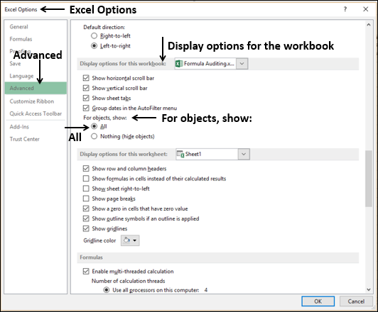
Setting the Display Option
You need to check whether the display options for the workbooks you are using are correctly set.
Click FILE > Options.
In the Excel Options dialog box, click Advanced.
In Display options for the workbook −
Select the workbook.
Check that under For objects, show, All is selected.
Repeat this step for all the workbooks you are auditing.

Slide 4
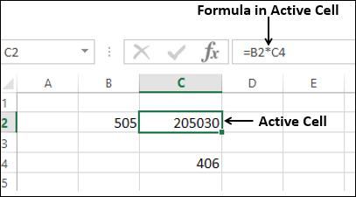
Tracing Precedents
Precedent cells are those cells that are referred to by a formula in the active cell.
In the following example, the active cell is C2. In C2, you have the formula =B2*C4.
B2 and C4 are precedent cells for C2.

Slide 5
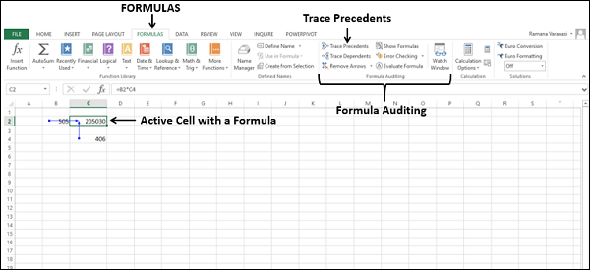
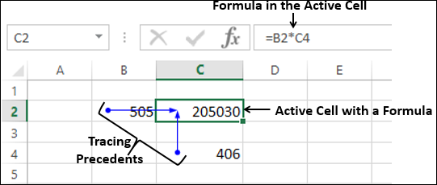
Tracing Precedents (Cntd…)
To trace the precedents of the cell C2,
Click in the cell C2.
Click the Formulas tab.
Click Trace Precedents in the Formula Auditing group
Two arrows, one from B2 to C2 and another from C4 to C2 will be displayed, tracing the precedents.

Slide 6
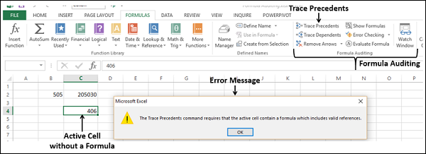
Tracing Precedents (Cntd…)
Note that for tracing precedents of a cell, the cell should have a formula with valid references. Otherwise, you will get an error message.
Click in a cell that does not contain a formula or click in an empty cell.
Click Trace Precedents in the Formula Auditing group.
You will get a message.

Slide 7
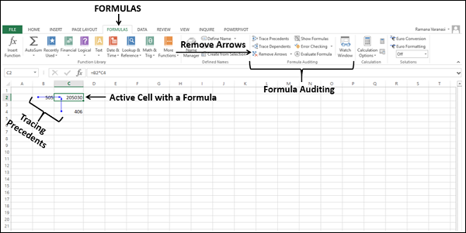
Removing Arrows
Click Remove Arrows in the Formula Auditing group. All the arrows in the worksheet will disappear.

Slide 8
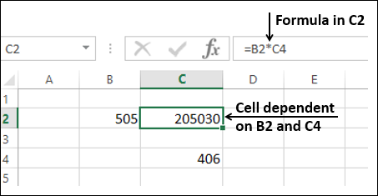
Tracing Dependents
Dependent cells contain formulas that refer to other cells. That means, if the active cell contributes to a formula in another cell, the other cell is a dependent cell on the active cell.
In the example below, C2 has the formula =B2*C4. Therefore, C2 is a dependent cell on the cells B2 and C4

Slide 9
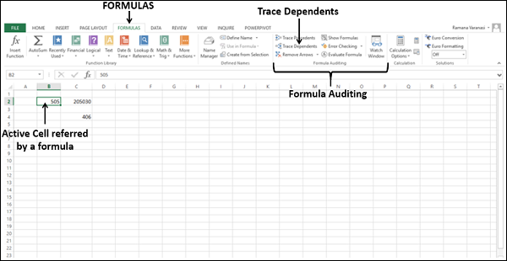
Tracing Dependents (Cntd…)
To trace the dependents of the cell B2,
Click in the cell B2.
Click the Formulas tab.
Click Trace Dependents in the Formula Auditing group.

Slide 10
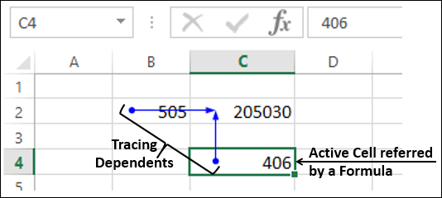
Tracing Dependents (Cntd…)
An arrow appears from B2 to C2, showing C2 is dependent on B2.
To trace the dependents of the cell C4 −
Click in the cell C4.
Click the Formula tab > Trace Dependents in the Formula Auditing group.
Another arrow appears from C4 to C2, showing C2 is dependent on C4 also. Click Remove Arrows in the Formula Auditing group. All the arrows in the worksheet will disappear.

Slide 11
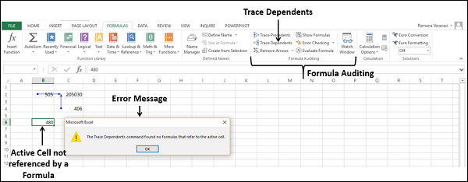
Tracing Dependents (Cntd…)
Note − For tracing dependents of a cell, the cell should be referenced by a formula in another cell. Otherwise, you will get an error message.
Click in the cell B6 is not referenced by any formula or click in any empty cell.
Click Trace Dependents in the Formula Auditing group. You will get a message.

Slide 12
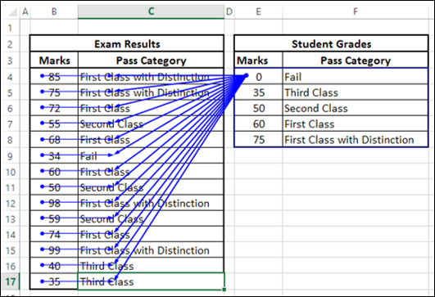
Working With Formulae
You have understood the concept of Precedents and Dependents. Now, consider a worksheet with several formulae.
Click in a cell under Pass Category in Exam Results table.
Click Trace Precedents. The cell to its left (Marks) and the range E4:F8 will be mapped as the precedents.
Repeat for all the cells under Pass Category in Exam Results table.

Slide 13
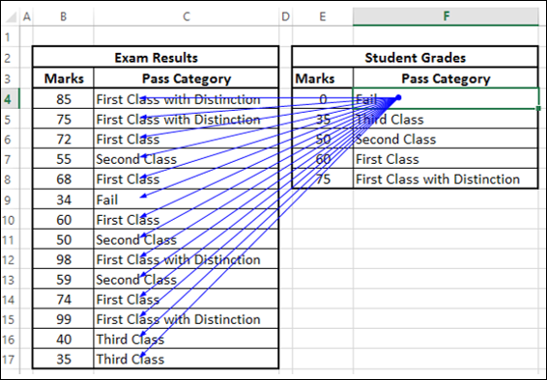
Working With Formulae (Cntd…)
Click in a cell under Pass Category in Student Grades table.
Click Trace Dependents. All the cells under Pass Category in Exam Results table will be mapped as the dependents

Slide 14
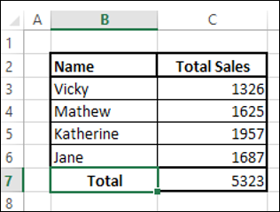
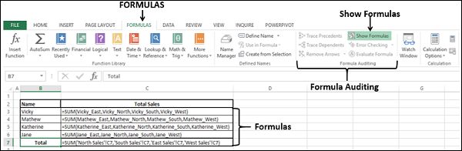
Showing Formulas
The worksheet on the right side contains the summary of sales by the salespersons in the regions East, North, South, and West.
Click the FORMULAS tab on the Ribbon.
Click Show Formulas in the Formula Auditing group. The Formulas in the worksheet will appear, so that you will know which cells contain formulas and what the formulas are.

Slide 15
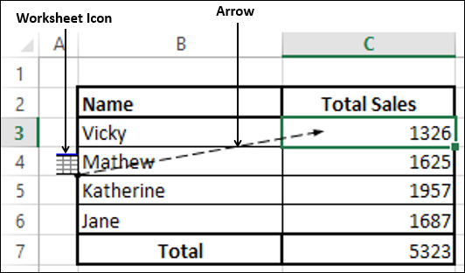
Showing Formulas (Cntd…)
Click in a cell under TotalSales.
Click Trace Precedents. A worksheet icon appears at the end of the arrow. The worksheet icon indicates that the precedents are in a different worksheet.

Slide 16
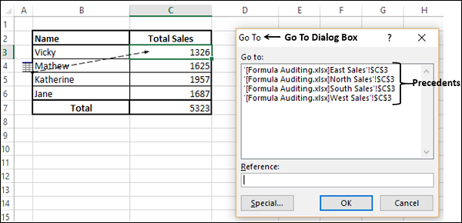
Showing Formulas (Cntd…)
Double-click on the arrow. A Go TO dialog box appears, showing the precedents
As you observe, there are four precedents, on four different worksheets.
Click a reference of one of the precedents.
The reference appears in the Reference box.
Click OK. The worksheet containing that precedent appears.

Slide 17
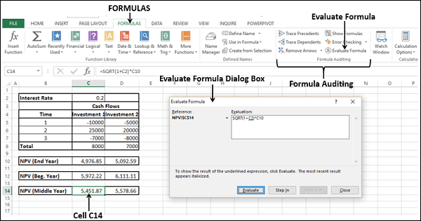
Evaluating a Formula
To find how a complex formula in a cell works step by step, you can use Evaluate Formula command.
Consider the formula NPV (Middle Year) in the cell C14. The formula is
=SQRT (1 + C2)*C10
Click in the cell C14.
Click the FORMULAS tab on the Ribbon.
Click Evaluate Formula in the Formula Auditing group. The Evaluate Formula dialog box appears.

Slide 18
Evaluating a Formula (Cntd…)
In the Evaluate Formula dialog box, the formula is displayed in the box under Evaluation. By clicking the Evaluate button several times, the formula gets evaluated step-wise. The expression with an underline will always be executed next.

Slide 19
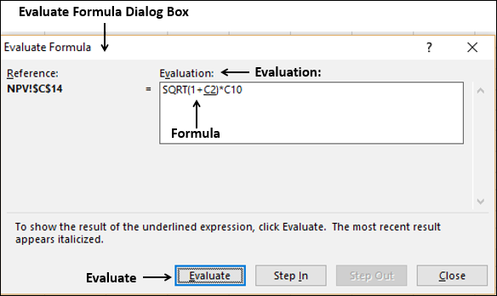
Evaluating a Formula (Cntd…)
Here, C2 is underlined in the formula. So, it is evaluated in the next step. Click Evaluate.

Slide 20
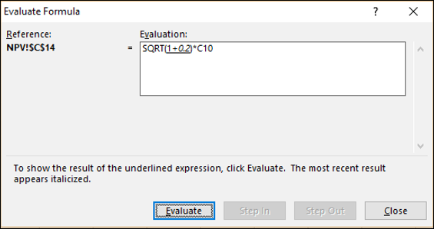
Evaluating a Formula (Cntd…)
Cell C2 has value 0.2. Hence, C2 will be evaluated as 0.2. 1+0.2 is underlined showing it as the next step. Click Evaluate.

Slide 21
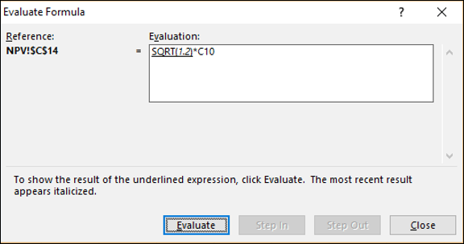
Evaluating a Formula (Cntd…)
1+0.2 will be evaluated as 1.2. SQRT(1.2) is underlined showing it as next step. Click Evaluate.

Slide 22
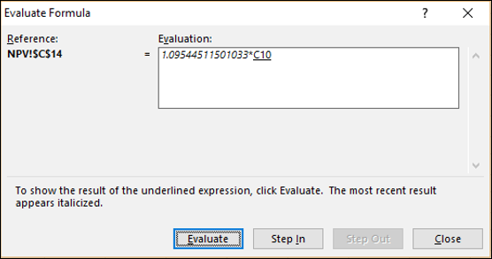
Evaluating a Formula (Cntd…)
SQRT(1.2) will be evaluated as 1.09544511501033. C10 is underlined showing it as next step. Click Evaluate.

Slide 23
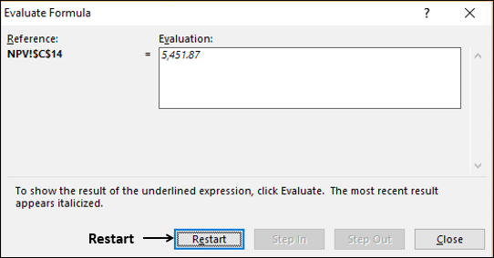
Evaluating a Formula (Cntd…)
1.09544511501033*4976.8518518515 will be evaluated as 5,451.87.
There are no more expressions to evaluate and this is the answer. The Evaluate button will be changed to Restart button, indicating completion of evaluation.

Slide 24
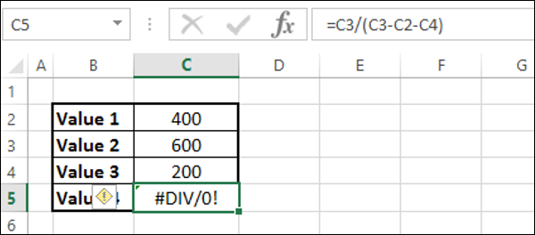
Error Checking
It is a good practice to do an error check once your worksheet and/or workbook is ready with calculations.
Consider the following simple calculations.

Slide 25
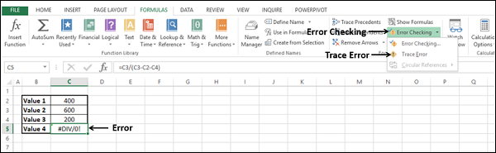
Error Checking (Cntd…)
The calculation in the cell has resulted in the error #DIV/0!.
Click in the cell C5.
Click the FORMULAS tab on the Ribbon.
Click the arrow next to Error Checking in the Formula Auditing group. In the drop-down list, you will find that Circular References is deactivated, indicating that your worksheet has no circular references.
Select Trace Error from the drop-down list.

Slide 26
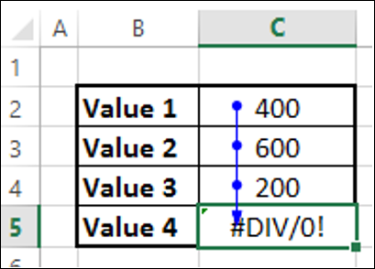
Error Checking (Cntd…)
The cells needed to compute the active cell are indicated by blue arrows.
Click Remove Arrows.
Click the arrow next to Error Checking.
Select Error Checking from the drop-down list.

Slide 27
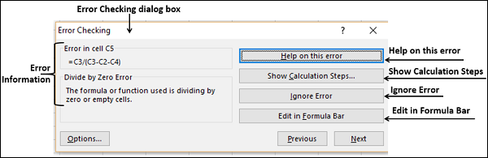
Error Checking (Cntd…)
The Error Checking dialog box appears.

Slide 28
Error Checking (Cntd…)
Observe the following −
If you click Help on this error, Excel help on the error will be displayed.
If you click Show Calculation Steps, Evaluate Formula dialog box appears.
If you click Ignore Error, the Error Checking dialog box closes and if you click Error Checking command again, it ignores this error.
If you click Edit in Formula Bar, you will be taken to the formula in the formula bar, so that you can edit the formula in the cell.

Slide 29
Analyze Data in Excel

Slide 30
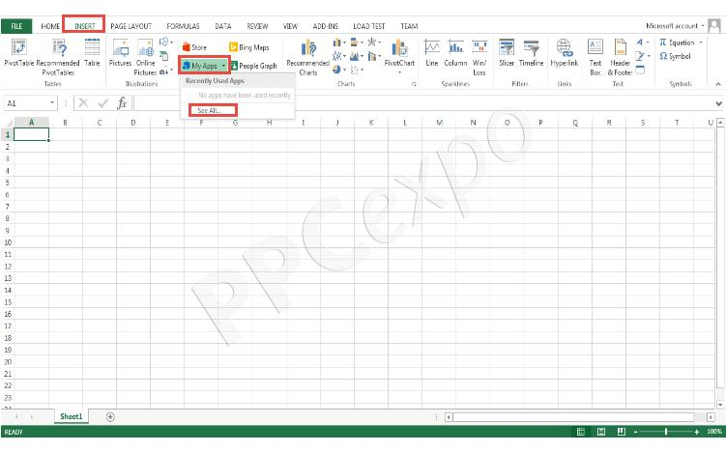
Analyze Data
Open your Excel application.
Open your spreadsheet and click INSERT from the top toolbar. From the drop-down menu, you will see My Apps.
Click on My Apps and then click to See All

Slide 31
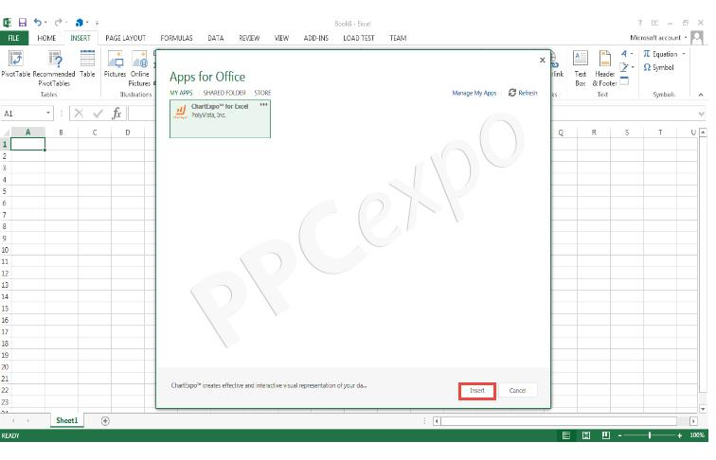
Analyze Data (Cntd…)
If you’ve already added ChartExpo for Excel, you’ll see it available. Otherwise, you’ll have to visit the Microsoft Office Store and download the free plugin.
Once you’ve installed ChartExpo, select the add-in and click on the Insert button.

Slide 32
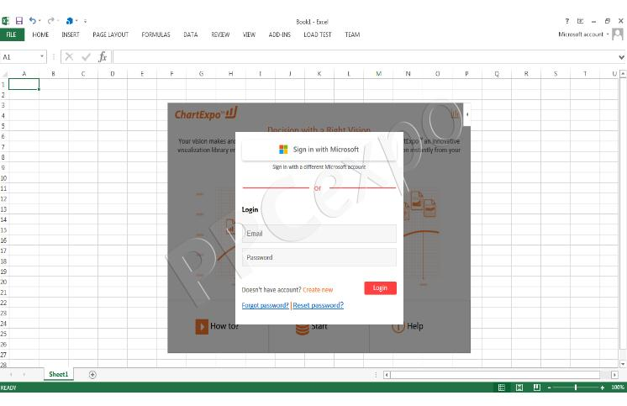
Analyze Data (Cntd…)
By clicking insert, you’ll add ChartExpo to your Excel environment.
You’ll be asked to log in with your Microsoft account. If you don’t have one, you can create one for free.
It’s worth mentioning that you are only required to log into your Microsoft Account the first time you access ChartExpo. Each time you use the plugin after, you will not have to undergo this step

Slide 33
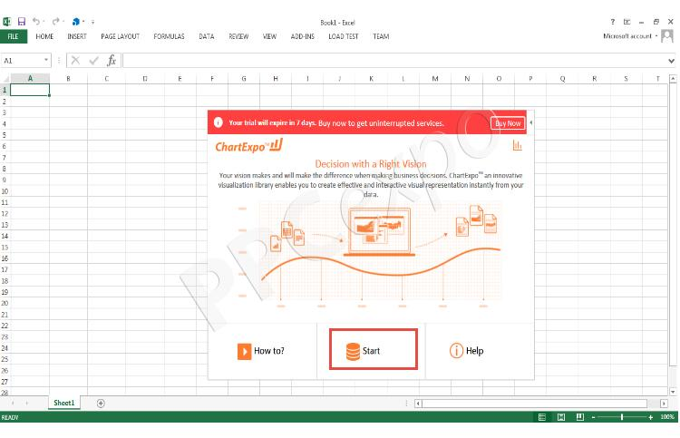
Analyze Data (Cntd…)
At this stage, you are ready to begin using ChartExpo. You have access to the entire library of charts and visualizations. Click on the start button to continue.

Slide 34
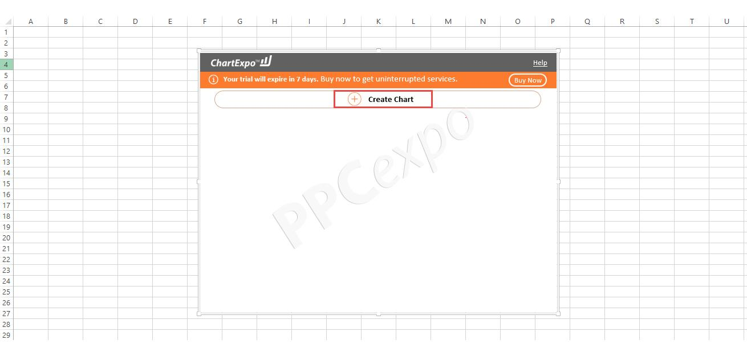
Analyze Data (Cntd…)
Click Create Chart to get started.

Slide 35
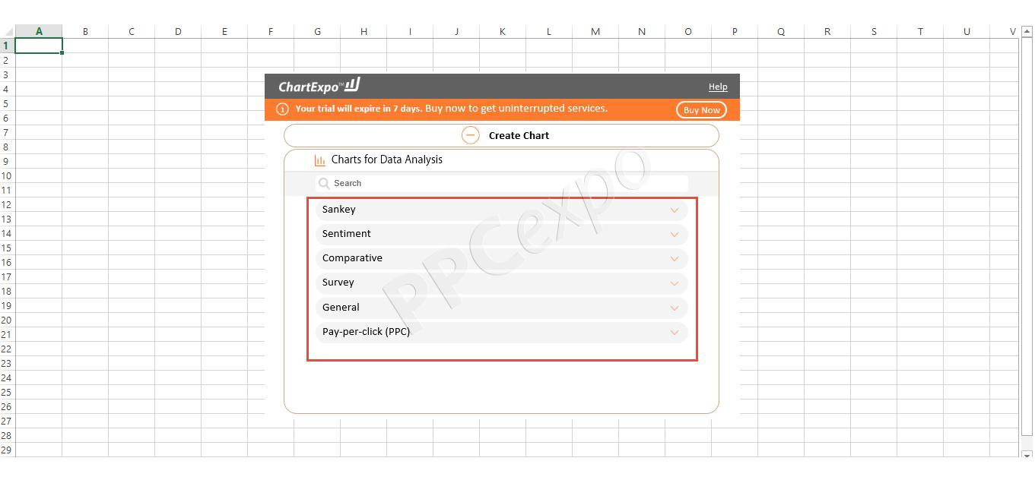
Analyze Data (Cntd…)
Next, you’ll see a list of different chart categories. You can select any group to expand it and see the individual charts available under that category.

Slide 36
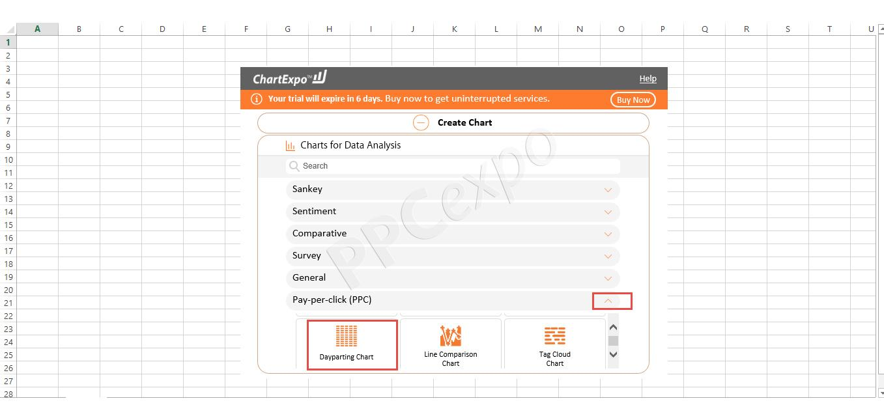
Analyze Data (Cntd…)
Let’s say you are running a Google Ads campaign and you want to analyze your ad impressions by time. You can select the Pay-per-click (PPC) category and then choose the Dayparting Chart.

Slide 37
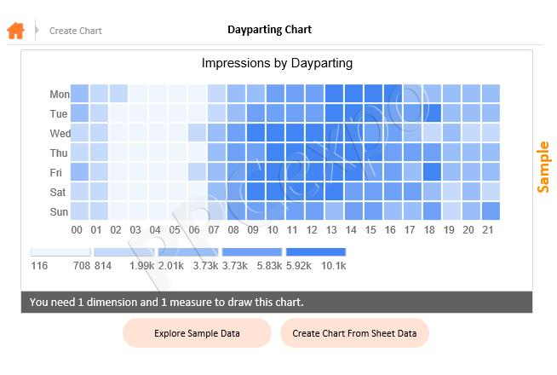
Analyze Data (Cntd…)
Once you create the chart, you’ll see a sample Dayparting chart that looks like this:

Slide 38
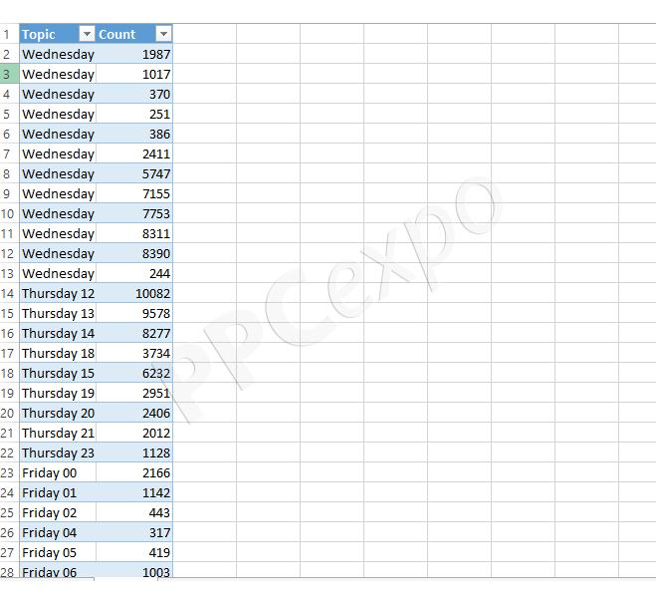
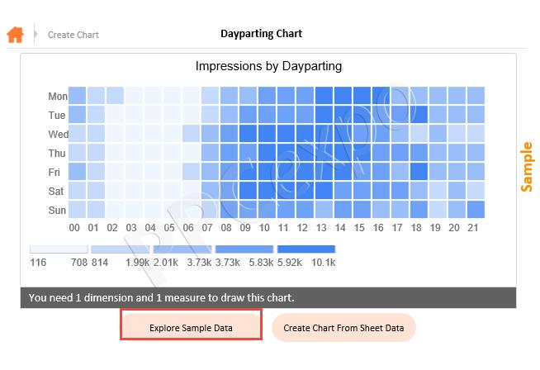
Analyze Data (Cntd…)
By clicking Explore Sample Data, the data will be automatically added to your spreadsheet.

Slide 39
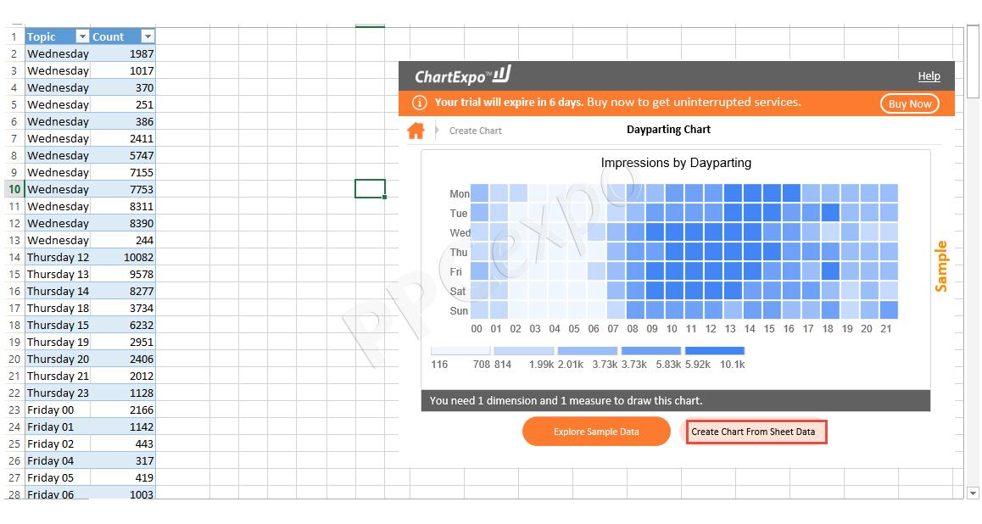
Analyze Data (Cntd…)
You can change the data in this table to reflect your campaigns’ data. After adding your own data, click on the Create Chart From Sheet Data Option

Slide 40
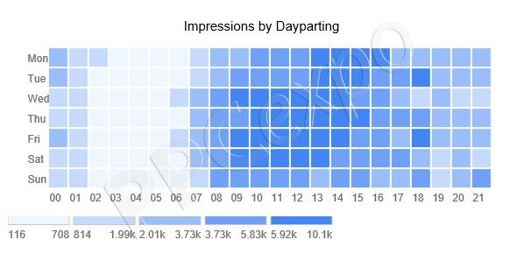
Analyze Data (Cntd…)
This will change the Dayparting chart to reflect your own data.

Slide 41
Consolidate Data in Excel

Slide 42
Why Consolidate Data?
To summarize and report results from separate worksheets, you can consolidate data from each sheet into a master worksheet. The sheets can be in the same workbook as the master worksheet, or in other workbooks. When you consolidate data, you assemble data so that you can more easily update and aggregate as necessary.

Slide 43
Ways to Consolidate Data?
There are two ways to consolidate data, either by position or category.
Consolidation by position: The data in the source areas has the same order, and uses the same labels. Use this method to consolidate data from a series of worksheets, such as departmental budget worksheets that have been created from the same template.
Consolidation by category: When the data in the source areas is not arranged in the same order but uses the same labels. Use this method to consolidate data from a series of worksheets that have different layouts but have the same data labels.

Slide 44
How to Consolidate?
If you haven't already, set up the data in each constituent sheet by doing the following:
Ensure that each range of data is in list format. Each column must have a label (header) in the first row and contain similar data. There must be no blank rows or columns anywhere in the list.
Put each range on a separate worksheet, but don't enter anything in the master worksheet where you plan to consolidate the data. Excel will do this for you.
Ensure that each range has the same layout.
In the master worksheet, click the upper-left cell of the area where you want the consolidated data to appear.

Slide 45
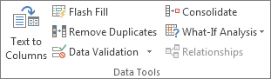
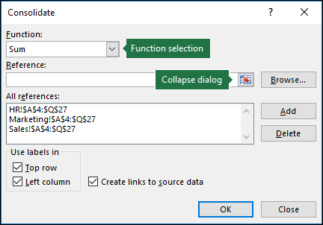
How to Consolidate? (Cntd…)
Click Data>Consolidate (in the Data Tools group).
In the Function box, click the summary function that you want Excel to use to consolidate the data. The default function is SUM.
Here is an example in which three worksheet ranges have been chosen:

Slide 46
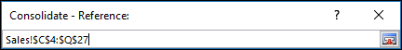
How to Consolidate? (Cntd…)
Select your data. Next, in the Reference box, click the Collapse button to shrink the panel and select the data in the worksheet
Click the worksheet that contains the data you want to consolidate, select the data, and then click the Expand Dialog button on the right to return to the Consolidate dialog. If a worksheet containing data that you need to consolidate is in another workbook, click Browse to locate that workbook. After locating and clicking OK, Excel will enter the file path in the Reference box and append an exclamation point to that path. You can then continue to select other data.
Here is an example in which three worksheet ranges have been chosen selected:

Slide 47
How to Consolidate? (Cntd…)
In the Consolidate popup window, click Add. Repeat this to add all of the ranges that you consolidate.
Automatic vs. Manual updates: If you want Excel to update your consolidation table automatically when the source data changes, simply check the Create links to source data box. If this box remains unchecked, you can update the consolidation manually.
Click OK, and Excel will generate the consolidation for you. Optionally, you can apply formatting. It's only necessary to format once, unless you rerun the consolidation.

Slide 48
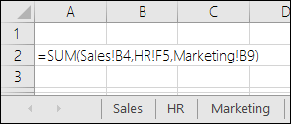
Use Formula to Consolidate Data
If the data to consolidate is in different cells on different worksheets:
Enter a formula with cell references to the other worksheets, one for each separate worksheet. For example, to consolidate data from worksheets named Sales (in cell B4), HR (in cell F5), and Marketing (in cell B9), in cell A2 of the master worksheet, you would enter the following:

Slide 49
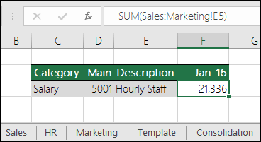
Use Formula to Consolidate Data (Cntd…)
If the data to consolidate is in the same cells on different worksheets:
Enter a formula with a 3-D reference that uses a reference to a range of worksheet names. For example, to consolidate data in cells A2 from Sales through Marketing inclusive, in cell E5 of the master worksheet you would enter the following:

Slide 50
Tasks
Find out the importance of formula auditing in Excel.
Find out the auditing tools in excel.
What does auditing do in excel.
Find out the steps of analyzing data in excel.
How can you consolidate data in excel?

Slide 51
THANKS

